Slide 1

Company Profile
(Ver. 1.5)

Slide 2
Contents
About HaSoInTech
History
Next Vision of HaSoInTech
Business Philosophy
Products

Slide 3
About HaSoInTech
Founded in 2001, HaSoInTech will be a leader in Global Scanner Technology Machines.
HaSoInTech specializes in Scanner Technology Machine products including: A4 Barcode Document Reader, ID Scanner, Lottery Ticket Scanner Module, Card Deposit, USB Solution,
EZ caller.
HaSoInTech outstanding performance in the global market is because of its efficient capabilities, manufacturing, quality control and product promotion.
HaSoInTech will provide technical assistance, sales support and express shipping.
HaSoInTech is ready to meet the demand for larger and rapidly growing global market.

Slide 4
History of HaSoInTech
2010s
2013. 6. Release of Quantum Scan
2012. 9. Release USB Extension Solution (HSIT-MUS)
2011. 5. Release Card Deposit Cartridge (HSIT-IDMC)
2010. 3. Release A6 Lottery Scanner Controller
2000s
2009. 5. Release A4 High Speed Scanner (HSIT-200B)
2005. 12. Registered Factory & Venture
2005. 11. Release of ID Card Scanner (HSIT-ID600)
2003. 5. Established R&D Center and registered Venture company
2002. 3. Release of EZ caller
2001. 9. Inauguration of company and release of Lotto Scan Module

Slide 5
Next Vision of HaSoInTech
○ High Speed Barcode Scanner (200 DPI)
○ Bank Note Scanner (600 DPI Color)
○ Barcode & OCR, MICR recognition Technology
○ Computer Telephony Integration
○ Recycling Recognition Module
○ Automatic Deposit Machine

Slide 6
Business Philosophy
Happiness
R&D Innovation
Integrity
Top
Quality
Confidence
○ Happiness
○ Confidence
○ R&D Innovation
○ Integrity
○ Top Quality

Slide 7
Products
High Speed
Scanner Processing Equipment

Slide 8

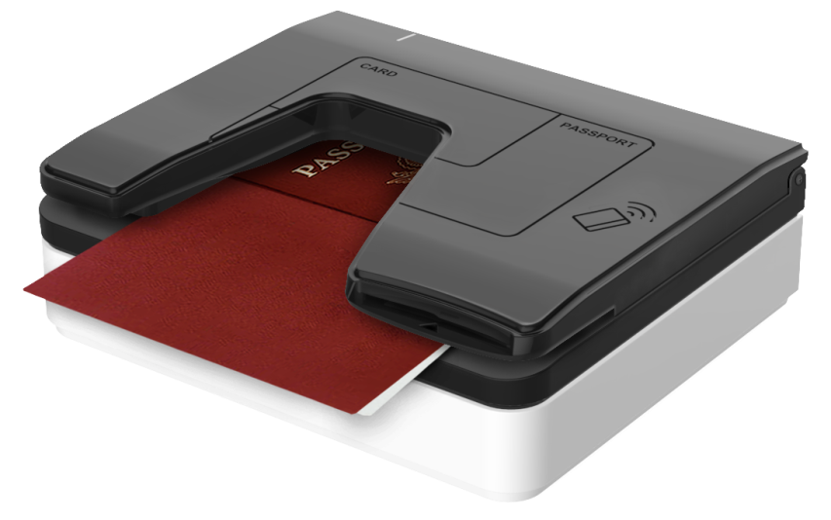
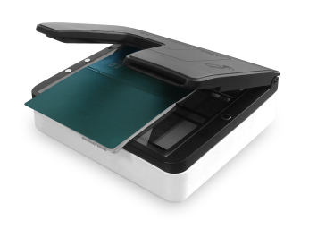
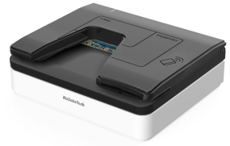
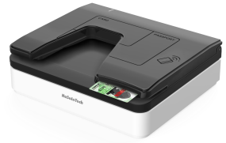
Quantum Scan Ⅱ
1. Feature
Flatbed scan technology
High Quality 300 DPI Color Scan
Supports Various type of illumination (White, RGB, IR)
Readable MRZ, OCR, BARCODE
USB 2.0 Interface
TWAIN Compatible
Optional Contact/Contactless SmartCard & SAM Slot
2. Specifications
3. Applications
Scan Area | 108(L) x 148(W) mm
Scan Resolution | Max. 300 DPI
Scan Speed | 1.0sec
Color | 24 bit True Color, IR
Scan File Format | BMP, JPG
Sensor Method | Flatbed CIS
S/W Interface | Supported TWAIN Driver
Interface | USB 2.0 High Speed
Power | AC 100~240V 50/60Hz / 12V 3A
Dimension | 202(W) x 170(D) x 79(H) mm
Weight | 1.1kg
4. Requirements
OS | Windows 10, 9, 8, 7 (32/64 bit, WHQL certified), Linux, Debian, CentOS

Slide 9
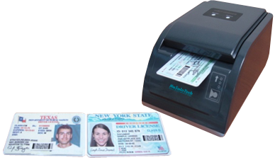
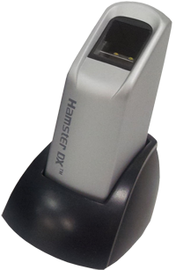
HSIT-ID600
ID CARD READER
1. Feature
Built-in Dual Side Color CIS
High Quality 600 DPI Color Scan
Duplex Image Scan
Readable OCR, BARCODE Recognition
Available BMP, TIF, JPG File Format
USB 2.0 Interface
Optional suspect ID Card Detection (UV, IR)
2. Specifications
3. Fingerprint Module (Option)
Card Size | ISO7811 Credit Card Size
Scan Resolution | 100 ~ 600 DPI Duplex
Scan Speed | Over 54 mm/sec
Color | 24 bit True Color, 8 Bit Gray
Scan File Format | BMP, TIF, JPG
Scan Side | Dual Side Scan (at once)
S/W Interface | Supported TWAIN Driver
Interface | USB 2.0 (USB Hub)
Power | DC 12V, 2.0A
Dimension | 117(W) x 171(D) x 79(H) mm
Weight | Approx. 740g
Interface Type | USB 1.1
Resolution | 500 DPI
Voltage | 5 V (USB Power)
Dimension (W x L x H) | 25.3 x 40.7 x 67.7 mm
4. Requirements
OS | Windows XP, Vista 7 32bit, 64bit, Linux, Android 4.0
CPU | Min. Pentium Ⅲ 1GHz
RAM | Min. 256MB

Slide 10
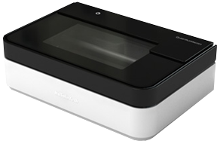
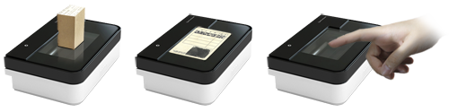
Quantum Scan
1. Feature
Flatbed scan technology
High Quality 600 DPI Color Scan
Readable OCR, BARCODE Recognition
Available BMP, JPG File Format
Easy to use in various field applications
(ID Card, Fingerprint & Stamp Etc.,)
USB 2.0 Interface
Optional suspect ID Card Detection (UV, IR)
Optional Rechargeable Battery
2. Specifications
3. Applications
Card Size | ISO7811 Credit Card Size
Scan Resolution | Max. 600 DPI
Scan Speed | Max. 1.2sec
Color | 24 bit True Color, IR Image (Suspect Detection)
Scan File Format | BMP, JPG
Sensor Method | Single CIS
S/W Interface | Supported TWAIN Driver
Interface | USB 2.0 High Speed
Power | AC 100~240V 50/60Hz / 12V 2.5A
Dimension | 159(W) x 106(D) x 55.6(H) mm
Weight | Approx. 563g / Battery Include 610g
4. Requirements
OS | Windows XP, Vista, 7, 8 (32/64bit) Linux, Android
CPU | Min. Pentium Ⅲ 1GHz
RAM | Min. 256MB

Slide 11
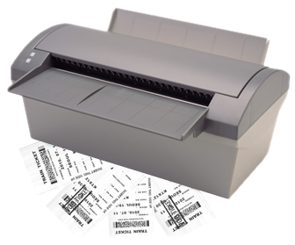
HSIT-200B
A4 Barcode Document Reader
Feature
Built-in Thermal Endorser
High Speed 200 DPI Color Scan
Excellent Cash & Ticket Processing System
Readable OCR, BARCODE(1D, 2D)
Available BMP, RAW, TIF, JPG File Format
USB 2.0 Interface
Optional Thermal Print Head
2. Specifications
3. Endorser
Paper Size | Max. 216 x 330 mm
Scan Resolution | 200 DPI RGB Color
Scan Speed | Max. 300 mm/sec
Color | 24 bit Color, 1, 4, 8 Bit Gray Color
Scan File Format | BMP, RAW, TIF, JPG
Interface | USB 2.0
Power | DC 24V, 2.5A
Dimension | 300(W) x 180(D) x 225(H) mm
Weight | Approx. 3.1g
Print Type | Thermal
Resolution | 200 DPI, 8dot/mm
Print Width | 24 mm
4. Barcode
1D | Code39, Code128, I2of5, UPC/EAN, Codebar, Code32,Code93
2D | PDF417,QR,Data Matrix

Slide 12
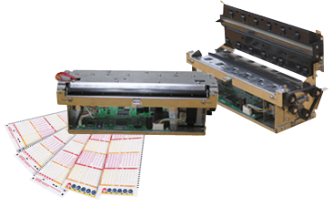
HSIT-200M
A4 Lottery Ticket Scanner Mechanism
with TPH
Feature
High Speed 200 DPI Color Scan
Excellent Lottery Ticket Processing
Readable OCR, BARCODE(1D, 2D)
Available BMP, RAW, TIF, JPG File Format
USB 2.0 Interface
Optional Thermal Print Head
2. Specifications
3. Endorser
Paper Size | Min. 75 x 70mm / Max. 216 x 330 mm
Scan Resolution | 200 DPI RGB Color
Scan Speed | Max. 480 mm/sec (Gray)
Color | 24 bit Color, 1, 4, 8 Bit Gray Color
Scan File Format | BMP, RAW, TIF, JPG
Interface | USB 2.0
Power | DC 24V, 2.5A
Dimension | 252(W) x 115.5(D) x 88.4(H) mm
Weight | Approx. 2.1kg
Print Type | Thermal
Resolution | 200 DPI, 8dot/mm
Print Width | 24 mm
4. Barcode
1D | Code39, Code128, I2of5, UPC/EAN, Codebar, Code32,Code93
2D | PDF417,QR,Data Matrix

Slide 13
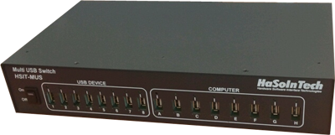
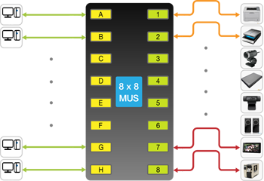
HSIT-MUS
USB Multi Switch Hub
1. Feature
Equipped with 8 upstream & downstream Ports
USB Peripheral sharing and switching
High Throughput (Max. 60m)
Easier Integration (Max. 8 Switches)
USB 2.0 Interface
Minimum Host Overhead
3. Applications
2. Specifications
PC
15m
30m
USB Printer
15m
30m
USB Scanner
PC
USB Digital Camera
Interface | USB 2.0
Connector | Available all types USB connector
Extension length | Max. 60m (From PC to Device)
Connection | Max. 8 PC & 8 USB
Power | AC 100~240V 50/60Hz / 12V 2.5A
Dimension | 345(W) x 200(D) x 75(H) mm
Weight | Approx. 2700g
USB External Hard
USB Web Cam
30m
USB Speaker
PC
15m
30m
USB Monitor (Display)
PC
15m
USB Special-purpose
printing machine
4. Requirements
OS | Windows XP, Vista, 7, 8 (32/64bit)
CPU | Min. Pentium Ⅲ 1GHz
RAM | Min. 256MB

Slide 14
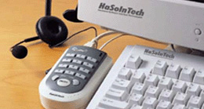
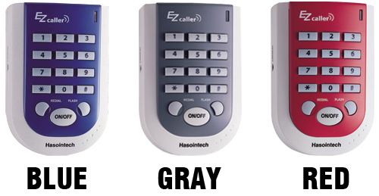
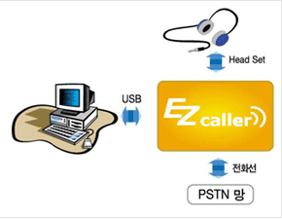
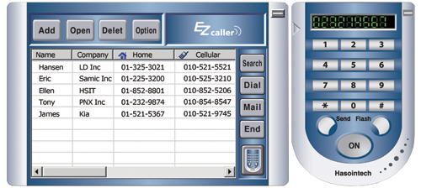
EZcaller with USB
EZcaller ?
  One-Click meets all your needs from taking a message while calling
  long continuous calls and program that is compatible with Outlook Express.
  It will make your job a whole lot easier. Easy installation with USB works independently with no additional power just like normal phone.
2. Features
  User-Friendly
  Easy Installation
  Low cost
  Powerful and stable
  Various Expansions
3. Program
4. Block Diagram

